Slide 1
TestStand API és PropertyObject-ek
Bihacker Csaba (CLD,CTD)

Slide 2
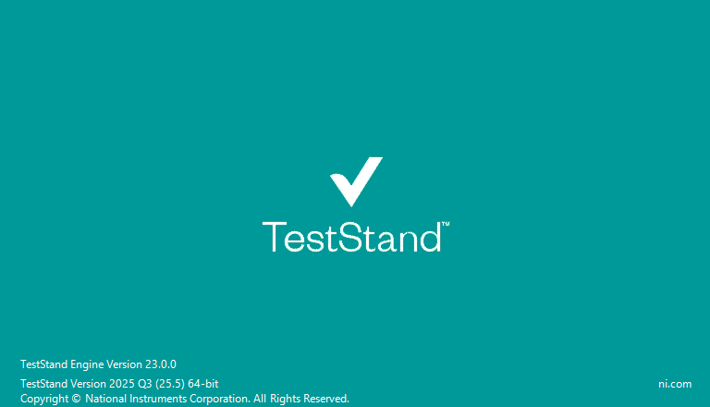
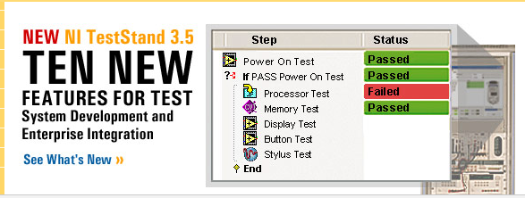
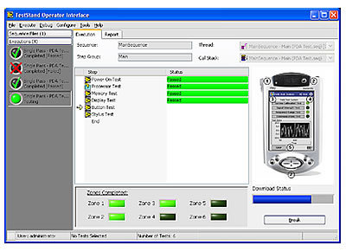



NI TestStand

Slide 3
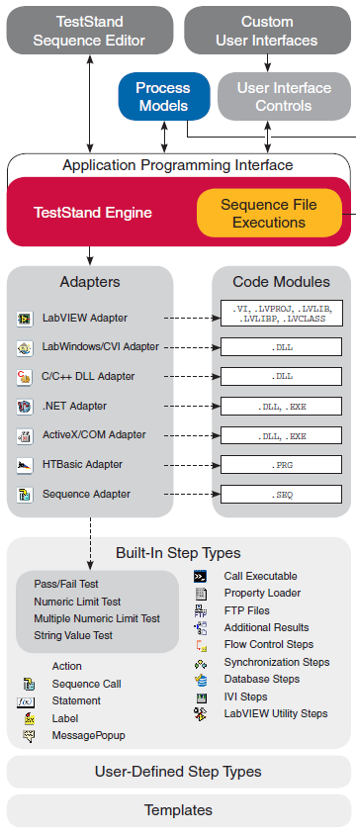
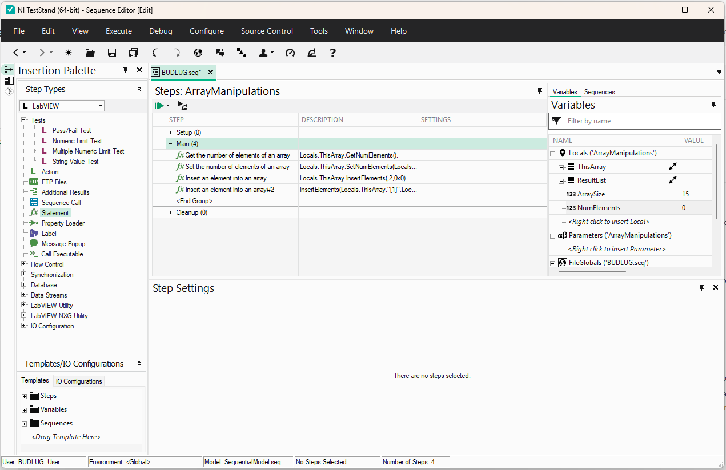
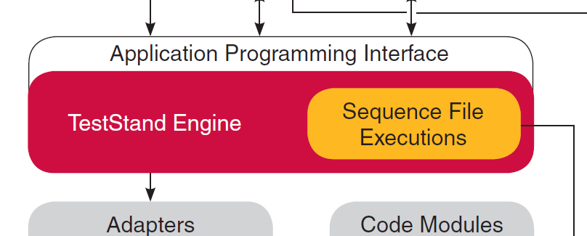
NI TestStand felépítése

Slide 4
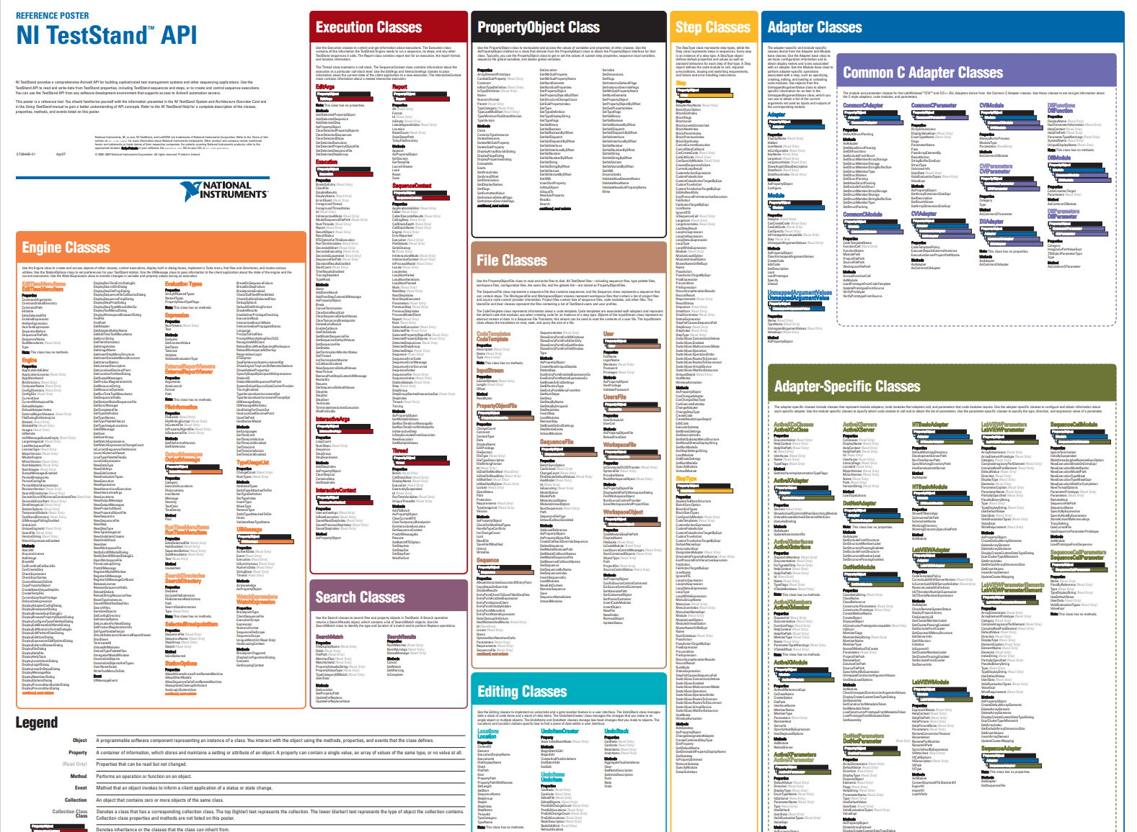
API osztályok
Engine Classes
Execution Classes
PropertyObject Class
Step Classes
Adapter Classes
File Classes
Search Classes
Editing Classes

Slide 5
Milyen állat a PropertyObject?
PropertyObject Class
Engine Classes OutputMessage
UIMessage
File Classes PropertyObjectFile SequenceFile Sequence
User
UsersFile
WorkSpaceFile
WorkSpaceObject
Execution Classes EditArgs Execution InteractiveArgs InteractiveContext Report SequenceContext Thread
Step Classes Step StepType
Adapter Classes Adapter Module UnmappedArgumentValue

Slide 6
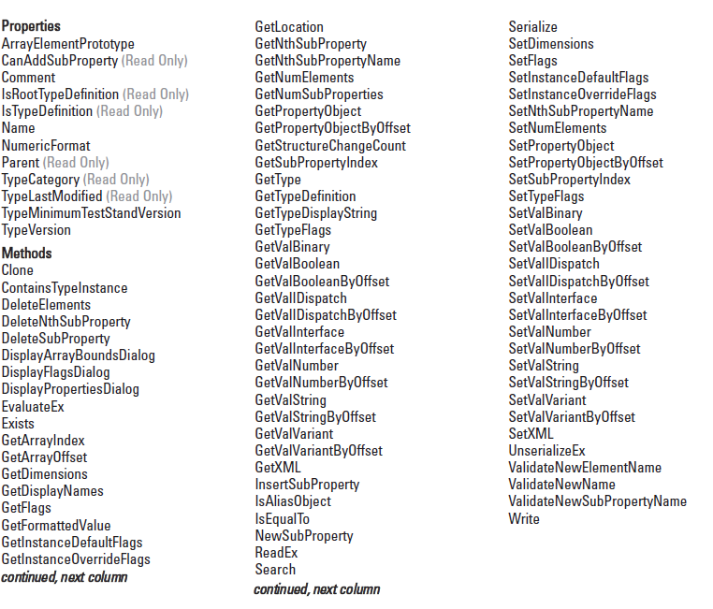
Milyen állat a PropertyObject?
PropertyObject Class

Slide 7
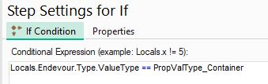
Hogyan bánjunk vele?
Paraméterek
PropertyObject.Comment
PropertyObject.Name
PropertyObject.Parent (Read Only)
PropertyObject.Type:
ArrayDimensions (Read Only)
DisplayString (Read Only)
ElementType (Read Only)
IsObject (Read Only)
Representation
TypeName (Read Only)
ValueType (Read Only)
PropValType_Array –(Value: 6)
PropValType_Boolean –(Value: 2)
PropValType_Container –(Value: 0).
PropValType_Enum –(Value: 7)
PropValType_NamedType –(Value: 4)
PropValType_Number –(Value: 3)
PropValType_Reference –(Value: 5)
PropValType_String –(Value: 1)

Slide 8
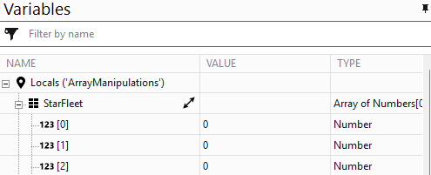
Hogyan bánjunk vele?
Array műveletek
PropertyObject.DeleteElements( arrayOffset, numElements, options = 0)
PropertyObject.GetArrayIndex( lookupString, options, arrayOffset)
PropertyObject.GetArrayOffset( lookupString, options, arrayIndex)
PropertyObject.GetNumElements
PropertyObject.InsertElements( arrayOffset, numElements, options = 0)
PropertyObject.SetNumElements( numElements, options = 0)

Slide 9
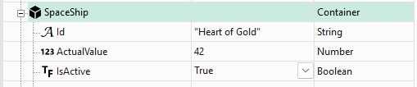
Hogyan bánjunk vele?
SubProperty műveletek
PropertyObject.DeleteNthSubProperty( lookupString, index, options)
PropertyObject.DeleteSubProperty( lookupString, options)
PropertyObject.GetNthSubProperty( lookupString, index, options)
PropertyObject.GetNthSubPropertyName( lookupString, index, options)
PropertyObject.GetNumSubProperties( lookupString)
PropertyObject.GetSubProperties( lookupString, options)
PropertyObject.GetSubPropertyIndex( lookupString, options, propName)
PropertyObject.InsertSubProperty( lookupString, options, index, subProperty)
PropertyObject.NewSubProperty( lookupString, ValueType, asArray, typeNameParam, options)

Slide 10
Hogyan bánjunk vele?
Get/Set Value műveletek
PropertyObject.GetValBinary( lookupString, options)
PropertyObject.GetValBoolean( lookupString, options)
PropertyObject.GetValIDispatch( lookupString, options)
PropertyObject.GetValInteger64( lookupString, options)
PropertyObject.GetValInterface( lookupString, options)
PropertyObject.GetValNumber( lookupString, options)
PropertyObject.GetValString( lookupString, options)
PropertyObject.GetValUnsignedInteger64( lookupString, options)
PropertyObject.GetValVariant( lookupString, options)

Slide 11
Hogyan bánjunk vele?
Get/Set Value műveletek #2
PropertyObject.SetValBinary( lookupString, options, newValue)
PropertyObject.SetValBoolean( lookupString, options, newValue)
PropertyObject.SetValIDispatch( lookupString, options, newValue)
PropertyObject.SetValInteger64( lookupString, options, newValue)
PropertyObject.SetValInterface( lookupString, options, newValue)
PropertyObject.SetValNumber( lookupString, options, newValue)
PropertyObject.SetValString( lookupString, options, newValue)
PropertyObject.SetValUnsignedInteger64( lookupString, options, newValue)
PropertyObject.SetValVariant( lookupString, options, newValue)

Slide 12
Hogyan bánjunk vele?
-> TestStand HELP!!!
PropertyOptions
PropOption_CaseInsensitive –(Value: 0x1000)
PropOption_Coerce –(Value: 0x301F8)
PropOption_CoerceBadNumbersToZero –(Value: 0x40000)
PropOption_CoerceFromBoolean –(Value: 0x20)
PropOption_CoerceFromEnum –(Value: 0xC0)
PropOption_CoerceFromNumber –(Value: 0x8)
PropOption_CoerceFromReference –(Value: 0x10000)
PropOption_CoerceFromString –(Value: 0x10)
PropOption_CoerceToBoolean –(Value: 0x100)
PropOption_CoerceToEnum –(Value: 0x18)
PropOption_CoerceToNumber –(Value: 0x40)
PropOption_CoerceToReference –(Value: 0x20000)
PropOption_CoerceToString –(Value: 0x80)
PropOption_CopyAllFlags –(Value: 0x20000000)
PropOption_DecimalPoint_UseComma –(Value: 0x3000)
PropOption_DecimalPoint_UsePeriod –(Value: 0x0)
PropOption_DecimalPoint_UsePreference –(Value: 0x1000)
PropOption_DecimalPoint_UseSystemSetting –(Value: 0x2000)
PropOption_DeleteIfExists –(Value: 0x2)
PropOption_DoNotAdoptCurrentName –(Value: 0x800)
PropOption_DoNothingIfExists –(Value: 0x4)
PropOption_DoNotRecurse –(Value: 0x4000)
PropOption_DoNotShareProperties –(Value: 0x8000000)
PropOption_InsertElement –(Value: 0x1)
PropOption_InsertIfMissing –(Value: 0x1
PropOption_NoOptions –(Value: 0x0)
PropOption_NotOwning –(Value: 0x200)
PropOption_ReferToAlias –(Value: 0x400)
PropOption_RemoveElement –(Value: 0x2)
PropOption_RequireIdenticalStructure –(Value: 0x2000)
PropOption_SetOnlyIfDoesNotExist –(Value: 0x5)
Bitmaszkolással számítható:
0x1 AND 0x4000

Slide 13
Hogyan bánjunk vele?
Get/Set Value műveletek #3: ugyanaz történik
ThisContext.Locals.ThisBool.SetValBoolean("", 0x0, TRUE)
ThisContext.Locals.SetValBoolean("ThisBool", 0x0, TRUE)
ThisContext.SetValBoolean("Locals.ThisBool ", 0x0, TRUE)

Slide 14

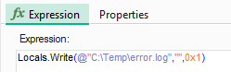
Hogyan bánjunk vele?
Általános PropertyObject függvények
PropertyObject.IsEqualTo( objectToCompare, options)
PropertyObject.Exists( lookupString, options)
PropertyObject.Write( pathString, objectName, RWoptions)

Slide 15
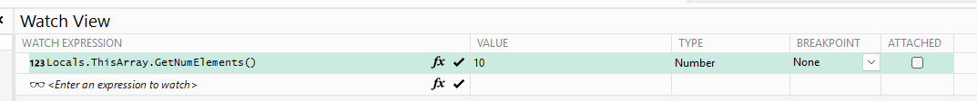
Hogyan bánjunk vele?
RunTime alatt meg lehet írni a Watch Expression panel-en az Expression-t, ami ott le is fog futni

Slide 16
Köszönöm
A példaprogram és a slide-ok elérhetők:
https:\\github.com\bihackercs\BUDLUG2025

